Slide 1
Robot Navigation Based on a Bayesian Classifier
Group2:
Sevag Tafnakaji,
Yaochen Song,
Fengyuan Liu
Notes:
För att lägga till text som ska synas på alla PPT-bilder:
Gå till topp-menyn, välj Visa > Bildbakgrund. På den allra första PPT-bilden, gör önskade ändringar i namn etc.
Stäng bakgrundsvy. Ny text kommer tränga igenom på alla PPT-bilder.
To add text in the slide master:
Go to the top menu, choose > View > Slide Master. In the absolute first slide, change to the preferred text.
Close Master View. The new text will permeate on all slides.
1

Slide 2
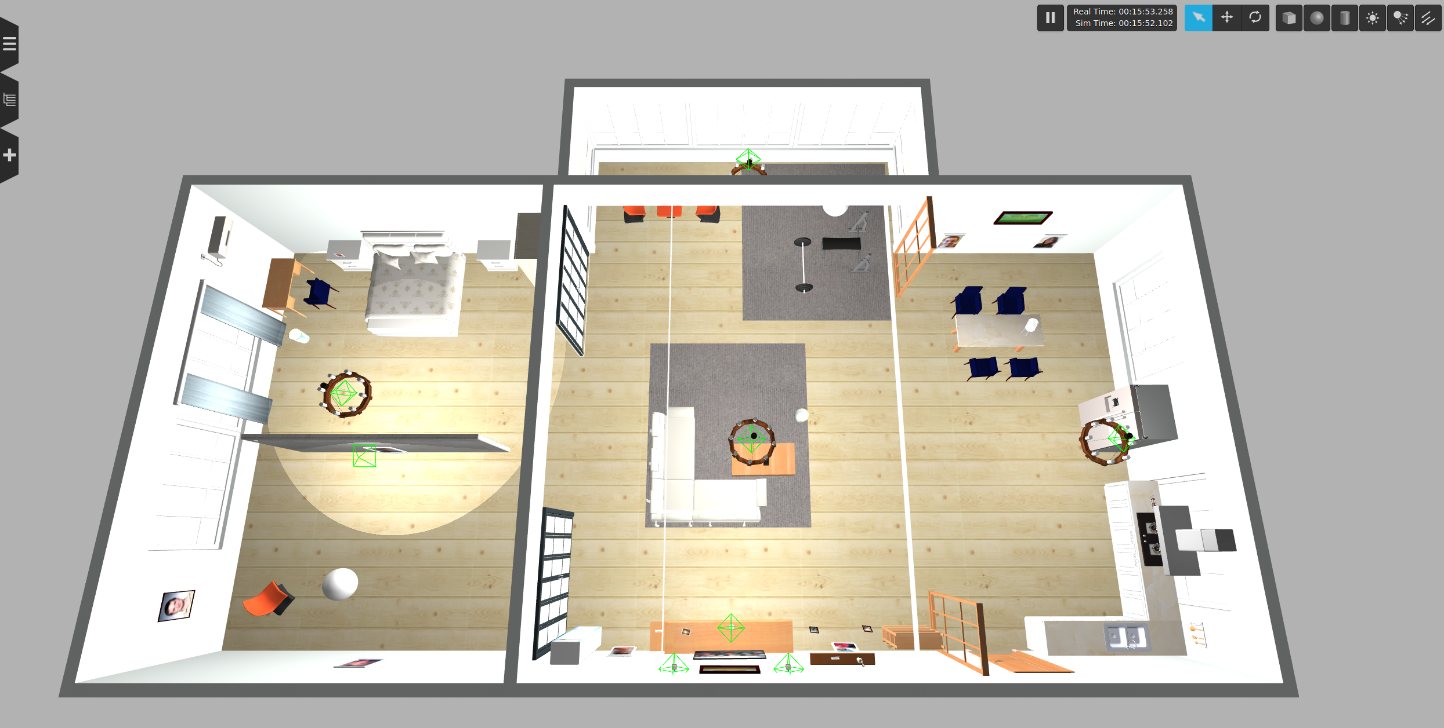
Motivation
In settings like homes, elderly care facilities, store, and more, such robots can significantly aid in tasks like fetching objects, thereby enhancing the quality of life for individuals who need assistance.
Figure 1: Example environment that robot is expected to work in.
Yaochen Song

Slide 3
Goal of this project
Primary goal: Provided an object, the robot/system should be able to reason and guess the most likely location to find said object.
Key sub-goals:
Perception: Using distance-based perception as used in the previous assignments.
Navigation: Using defined navigation stack for the TiaGo Robot from its workspace.
Reasoning and Decision-making: Prolog combined with pre-defined ontology, as well as classifiers with Bayesian approaches
Yaochen Song

Slide 4
Problem Definition
1. How to determine which area in the room an object might be in? 2. What is the navigation strategy when navigating to find an object? a) Should the robot travel to a “center” region of an area then sweep the area to find an object? What is optimal way to find the object if the robot knows it should be somewhere close-by? b) Since the system is probabilistic, at what point should the robot try the other options to find the object?
Yaochen Song

Slide 5
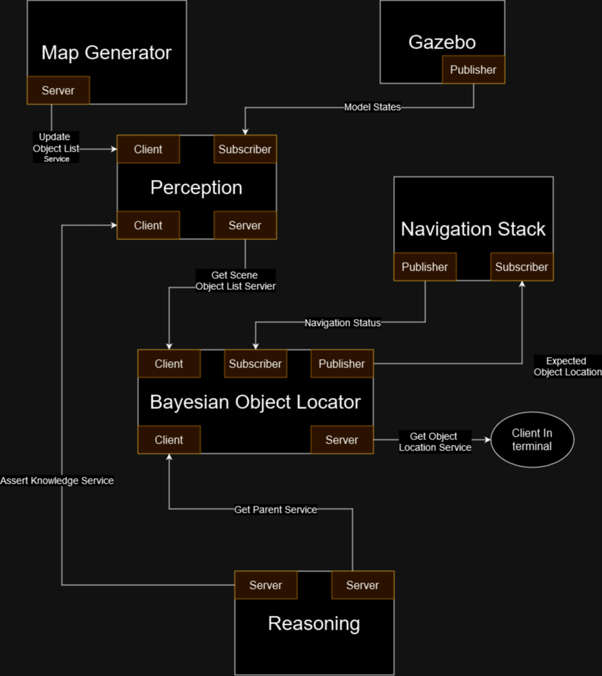
Method and implementation: Architecture
Yaochen Song
Figure 2: Architecture of this ROS package/Project.

Slide 6
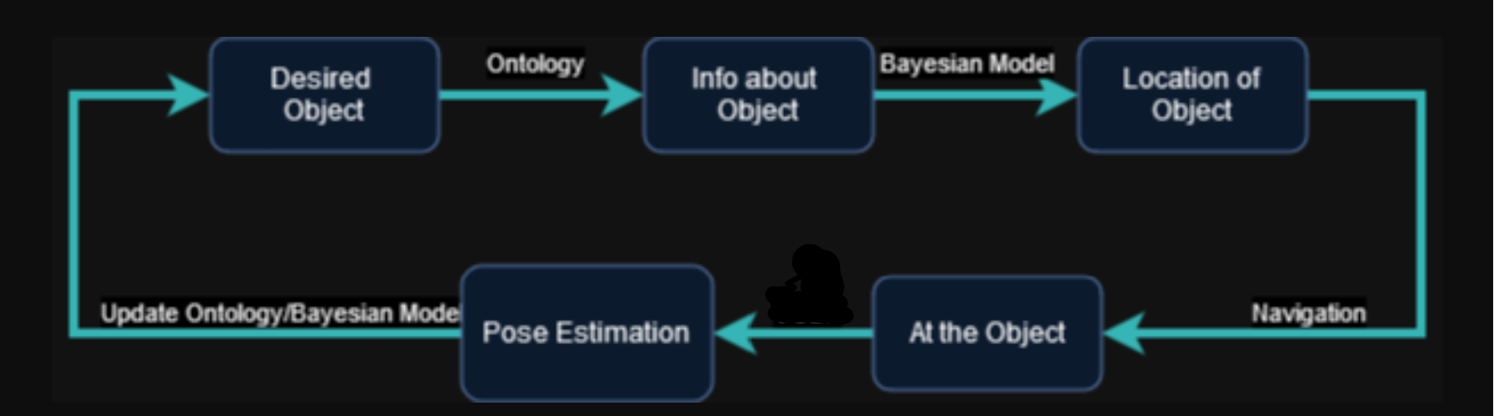
Method and implementation: Structure
A User-Defined Object Retrieval
B Knowledge Base and Prolog Logic
C Bayesian Classifier
D Navigation Search and Retrieval Process
Figure 3: Example Pipeline for this project.
6
Yaochen Song
Notes:
To add name and research group or other organisational affiliation, go to View > Slide master. Add name and affiliation in third slide (after the dark blue introduction slide). This will then be visible on all slides (except for template slide number 11, which consists of a collage of six images)
6

Slide 7
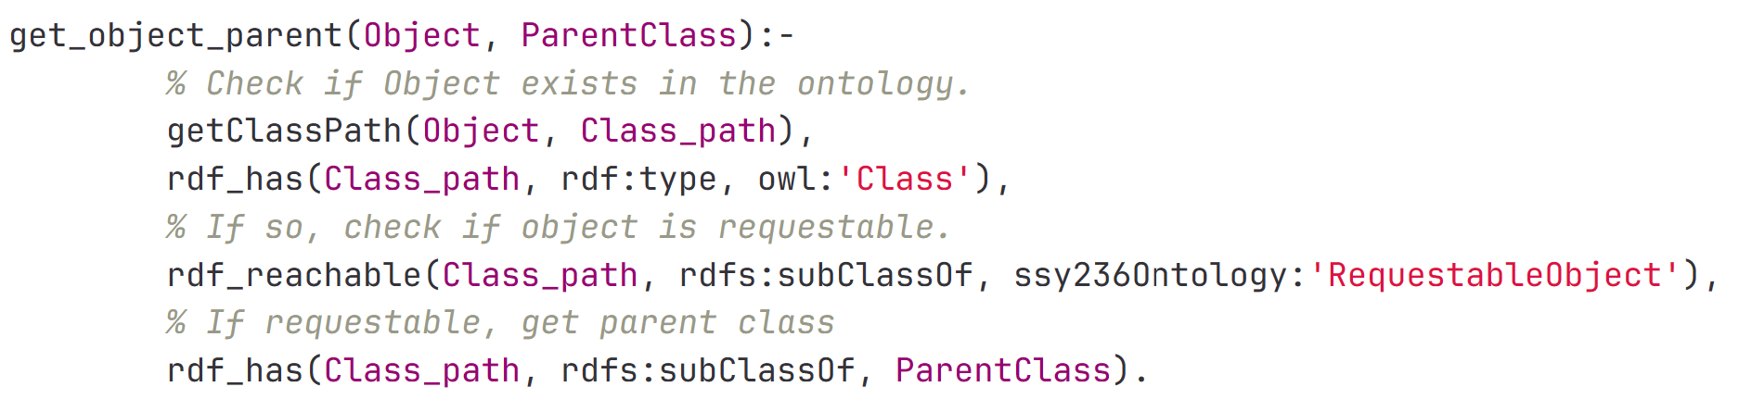
Method and implementation: Prolog
•Code Explanation
Code Overview:
•"getClassPath/2 retrieves the full class hierarchy path for the given object."
•"rdf_has/3 checks for the existence of the object within the specified class type."
•"rdf_reachable/3 determines if the object is requestable by checking if it is a subclass of 'RequestableObject'."
•"rdf_has/3 (second usage) identifies the direct parent class of the object."
Application: "These predicates collectively ascertain where in the hierarchy the object is situated, guiding the robot's search strategy."
7
Fengyuan Liu

Slide 8
Method and implementation: KB & Logic
•Ontological Knowledge Base
•"Utilizes a structured ontology for semantic classification of objects."
•"Enables hierarchical reasoning for object identification and retrieval."
•Role of Prolog in Logic Processing
•"Employs Prolog for querying and inferring relationships within the ontology."
•"Facilitates robust decision-making for object localization."
•"Use get_object_parent Function to discern the parent class of an object to guide search strategies and Verifie object’s existence and requestability within the 'RequestableObject' hierarchy
8
Fengyuan Liu
Notes:
To add name and research group or other organisational affiliation, go to View > Slide master. Add name and affiliation in third slide (after the dark blue introduction slide). This will then be visible on all slides (except for template slide number 11, which consists of a collage of six images)
8

Slide 9
Method and implementation: Bayesian Classifier
Introduction to Bayesian Classifier
Short description: "A Bayesian classifier applies Bayes' theorem to predict the probability of a label based on prior knowledge of conditions related to the label."
Relevance: Bayesian approach is particularly suited for object localization.
Gaussian Process Classifier
Definition: "A type of Bayesian classifier that uses Gaussian processes to predict the probability distribution of a continuous output."
Why Gaussian: "Chosen for its ability to provide uncertainty measurements on the predictions, which is crucial for robotic decision-making."
9
Fengyuan Liu
Notes:
To add name and research group or other organisational affiliation, go to View > Slide master. Add name and affiliation in third slide (after the dark blue introduction slide). This will then be visible on all slides (except for template slide number 11, which consists of a collage of six images)
9

Slide 10
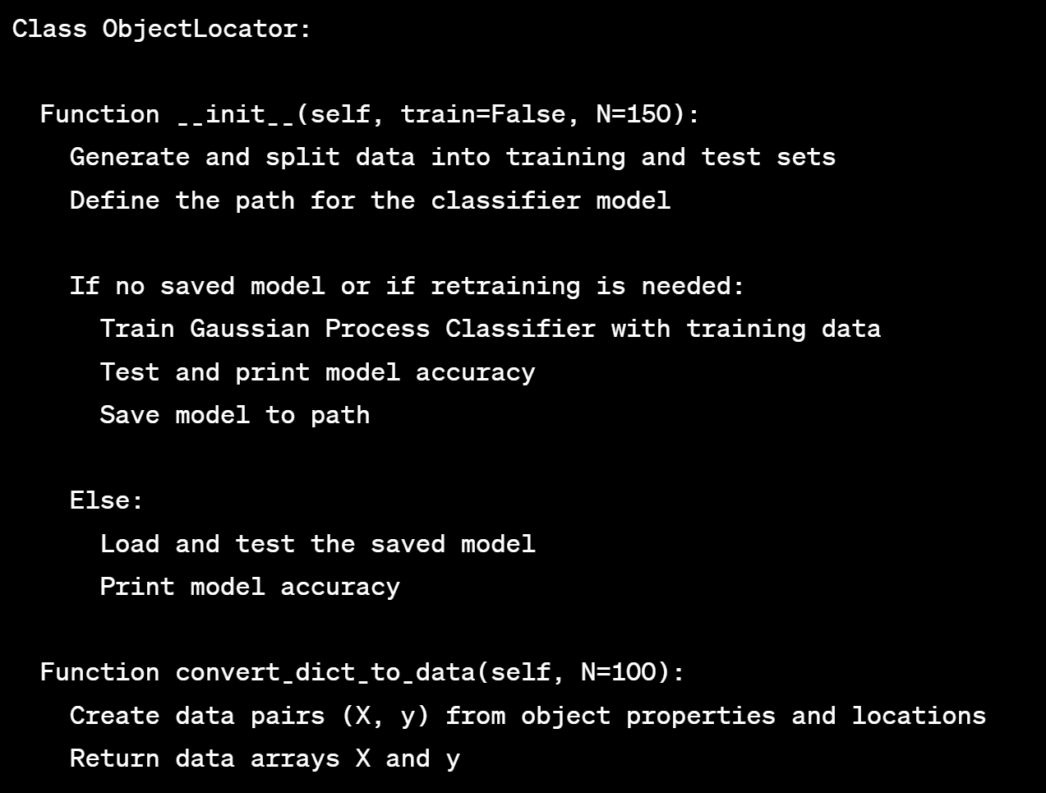
•Model Training
•Details on data: "Model is trained on a dataset of N=150 observations, including object weight, size, and usage context."
Method and implementation: Bayesian Classifier
•Training process: "The GaussianProcessClassifier is trained with an RBF kernel, a popular choice for its flexibility and efficiency in high-dimensional spaces."
Algorithm
10
Fengyuan Liu

Slide 11
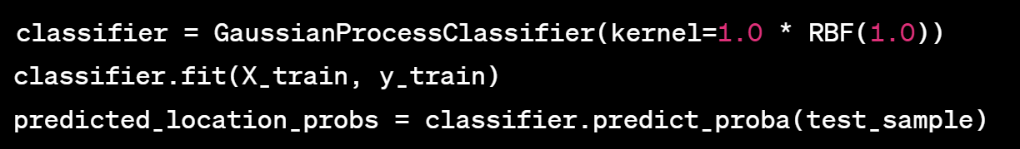
Method and implementation: Bayesian Classifier
•Model Performance
•Accuracy report: "Post-training, the model's accuracy is evaluated on a test set, providing a quantifiable measure of its predictive power."
•Model improvements: "If the model is not saved or further training is requested, the system re-trains the classifier to improve its accuracy, finally reach around 70~80%."
•Integration with Robotics
pseudo-code:
Figure 4: pseudo-code for bayesian classifier.
11
Sevag Tafnakaji

Slide 12
Method and implementation: Navigation Method
Navigation is the already available navigation stack found in the tiago workspace/tutorials. The following global/local planners were used:
Global Planner: Navfn - Used since it can find a path towards the goal even when the goal is in an obstacle.
Local Planner: TEB - Greedy local planner that finds shorter paths along the global path. Is good at object avoidance as well.
12
Sevag Tafnakaji​
Notes:
To add name and research group or other organisational affiliation, go to View > Slide master. Add name and affiliation in third slide (after the dark blue introduction slide). This will then be visible on all slides (except for template slide number 11, which consists of a collage of six images)
12

Slide 13
Method and implementation: Navigation Strategy
When the Gaussian Process Classifier returns the most likely location of the object, a strategy is needed to explore the surroundings:
Different search algorithms can be used: BFS, DFS, etc.
This implementation: Random poses around a central location and hope for the best.
Not optimal, cannot guarantee that the object would be found if it was there.
13
Sevag Tafnakaji​
Notes:
To add name and research group or other organisational affiliation, go to View > Slide master. Add name and affiliation in third slide (after the dark blue introduction slide). This will then be visible on all slides (except for template slide number 11, which consists of a collage of six images)
13

Slide 14
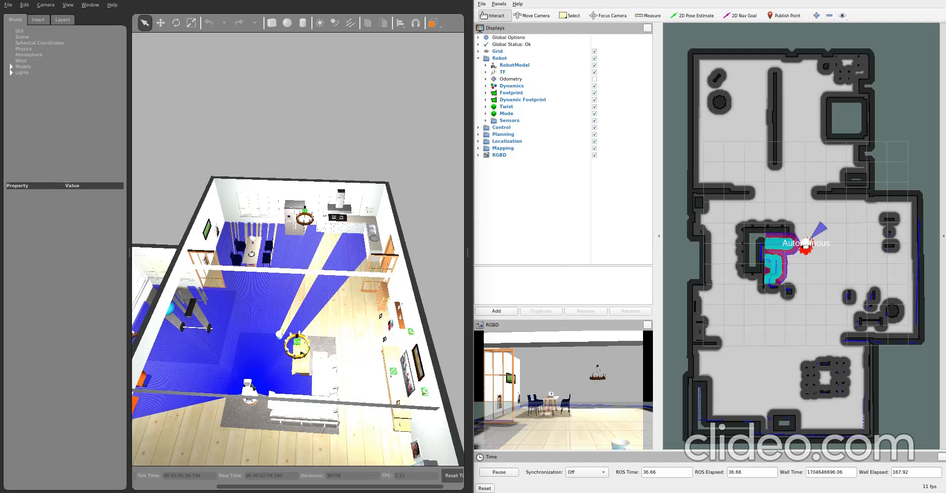
Results
Video Sped up 4x
14
Sevag Tafnakaji​
Notes:
To add name and research group or other organisational affiliation, go to View > Slide master. Add name and affiliation in third slide (after the dark blue introduction slide). This will then be visible on all slides (except for template slide number 11, which consists of a collage of six images)
14

Slide 15
Boundaries
System does not keep track of where it found previous objects, so it does not update the probability distributions.
Naive Bayesian approaches were not used because the different objects/locations are not independent from each other.
While the system creates different instances, it does not use different attributes of the instances to differentiate specific instances from each other. This means that if e.g. plate or orange has been found once, requesting it again would simply lead to it being immediately found.
Uses proximity based "object recognition" so it does not need to orient itself such that it faces the object it wants to find. This additional step would complicate the process/pipeline
Locations only specified in the kitchen but can very easily be expanded to include every room.
Use of non-optimized gaussian processes makes system slow, but only when deciding.
Must keep training data size small due to lack of optimization (speed of Gaussian Process depends on size of training data, O(N^3)).
No safeguard implemented for when a navigation goal is within in obstacle, can cause robot to get into a deadlock and can only be saved if a timeout occurs.
System does not learn about new locations/new objects. Can be added to Prolog/ontologies in future projects.
15
Sevag Tafnakaji​
Notes:
To add name and research group or other organisational affiliation, go to View > Slide master. Add name and affiliation in third slide (after the dark blue introduction slide). This will then be visible on all slides (except for template slide number 11, which consists of a collage of six images)
15

Slide 16
Conclusion
Even with minimal training data, the system works quite well.
Must be further tested with better navigation strategies, object detection (i.e., make the system more realistic and not reliant on data the user has from the simulation.)
16
Sevag Tafnakaji
Notes:
To add name and research group or other organisational affiliation, go to View > Slide master. Add name and affiliation in third slide (after the dark blue introduction slide). This will then be visible on all slides (except for template slide number 11, which consists of a collage of six images)
16

Slide 17
Logotype
Notes:
17

